Slide 1
Team10 – RAG:
Aleksejs, Nikolajs, Olegs, Yurii

Slide 2
Presentation/Demo content
Context and idea
What problem did we try to solve?
How and why AI helped.
[Demo!]
Insights
What worked?
What didn’t work (interesting failures)?
What surprised us?
What did we learn?

Slide 3
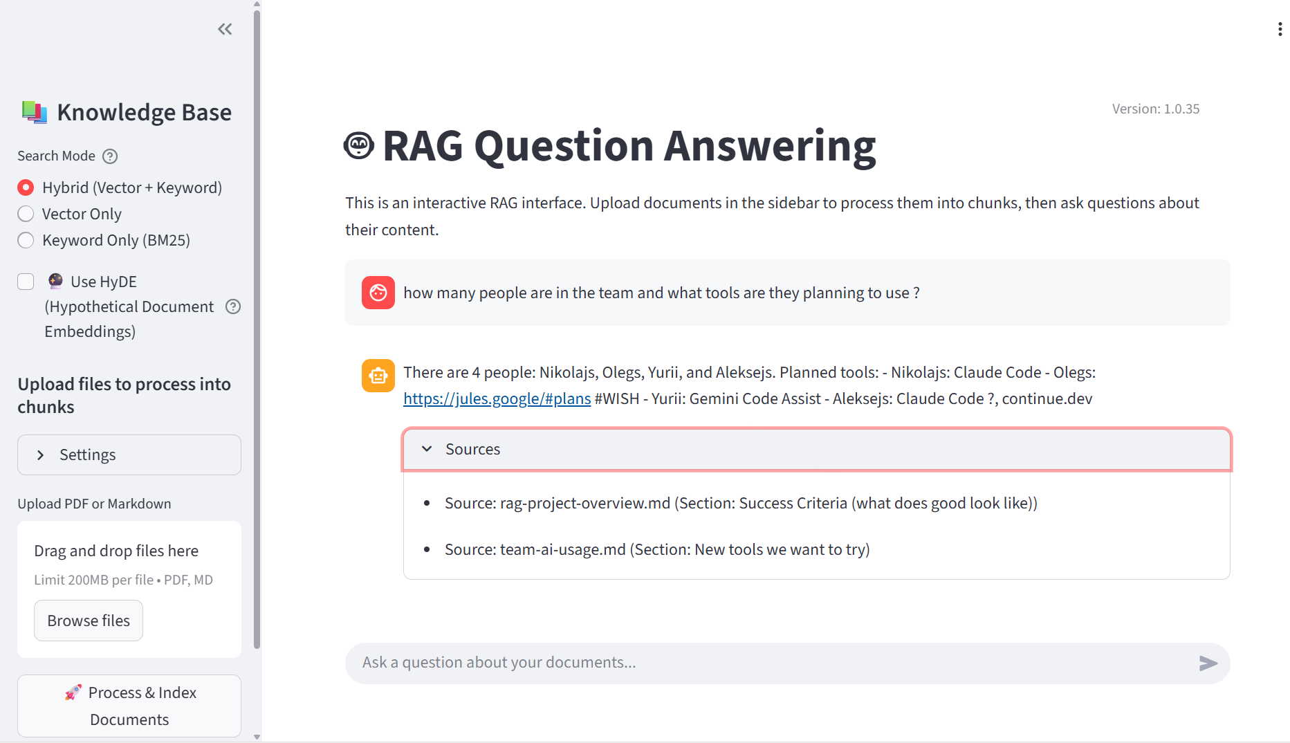
Result: https://hackdays.olegs.eu/

Slide 4
Presentation/Demo content
Context and idea
What problem did we try to solve?
How and why AI helped.
RAG lets you ask questions over large document collections efficiently.
It retrieves only the most relevant pieces and uses them to generate accurate, source-grounded answers - reducing cost, latency, and hallucinations.

Slide 5
Main vision
Use anything and everything that speeds us up

Slide 6
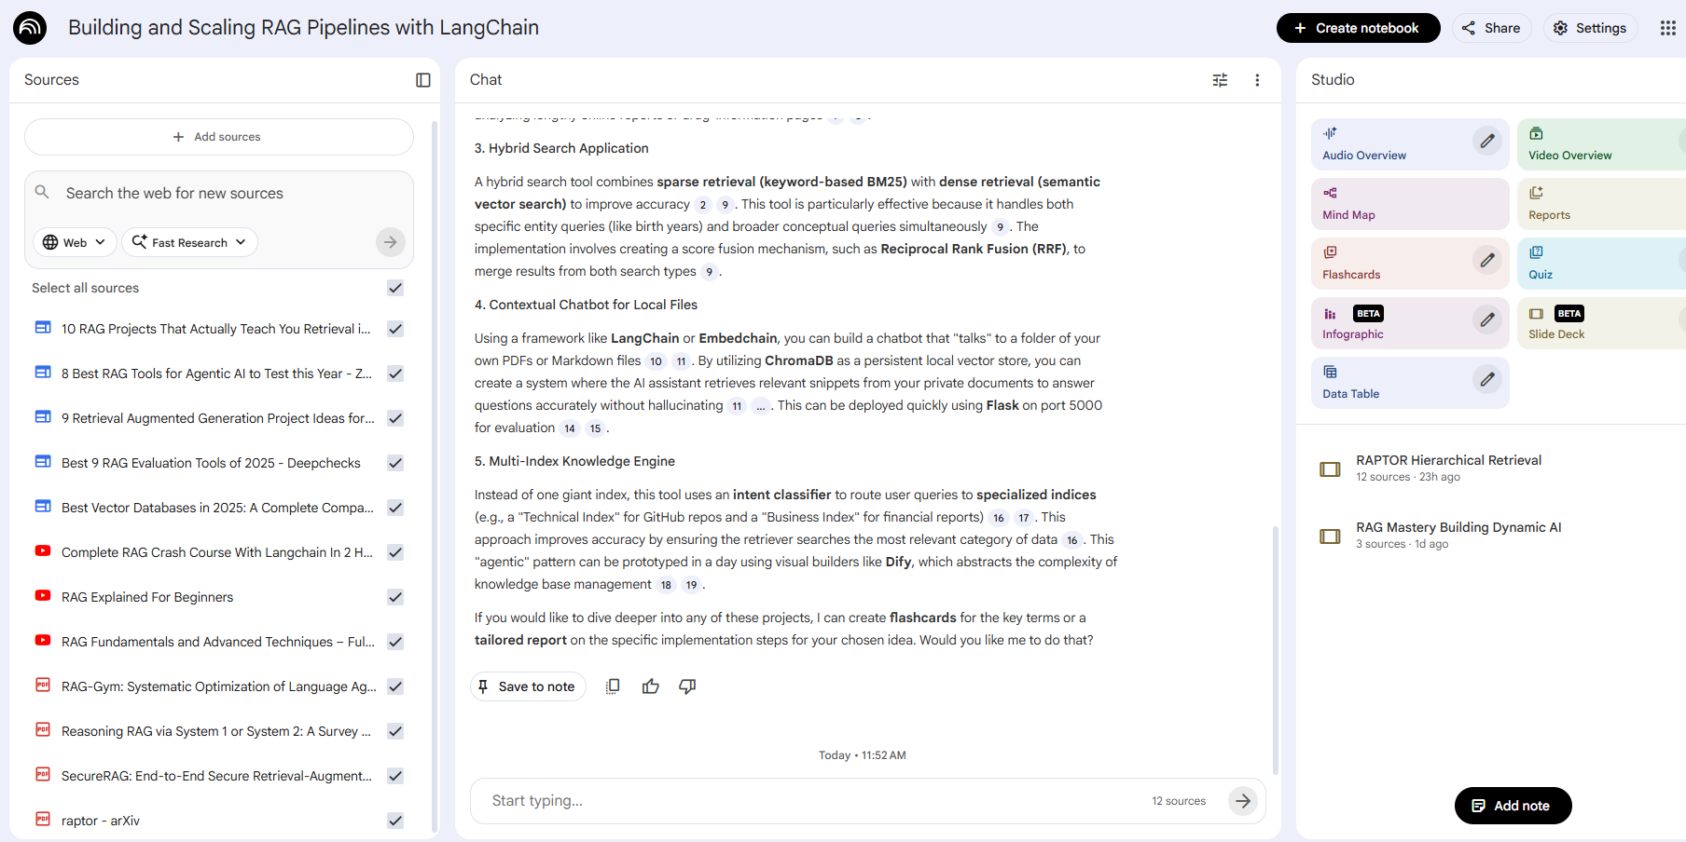
Step 1 idea generation
NotebookLM.google.com
Helped QUICKLY analyze YT, Website sources about subject and find project idea
It created a presentation for us to align us on RAG understanding

Slide 7
Step 2: project infrastructure development
Github repositoy: https://github.com/AleksejsKudrins/PaceraHackDaysRag
Github acitions for deployment
Linux server for hosting
Cloudflare to route traffic from domain to internal docker
Time spent: 4 hours
AI used for: everything, had an idea to implement and LLMs helped us get what we needed

Slide 8
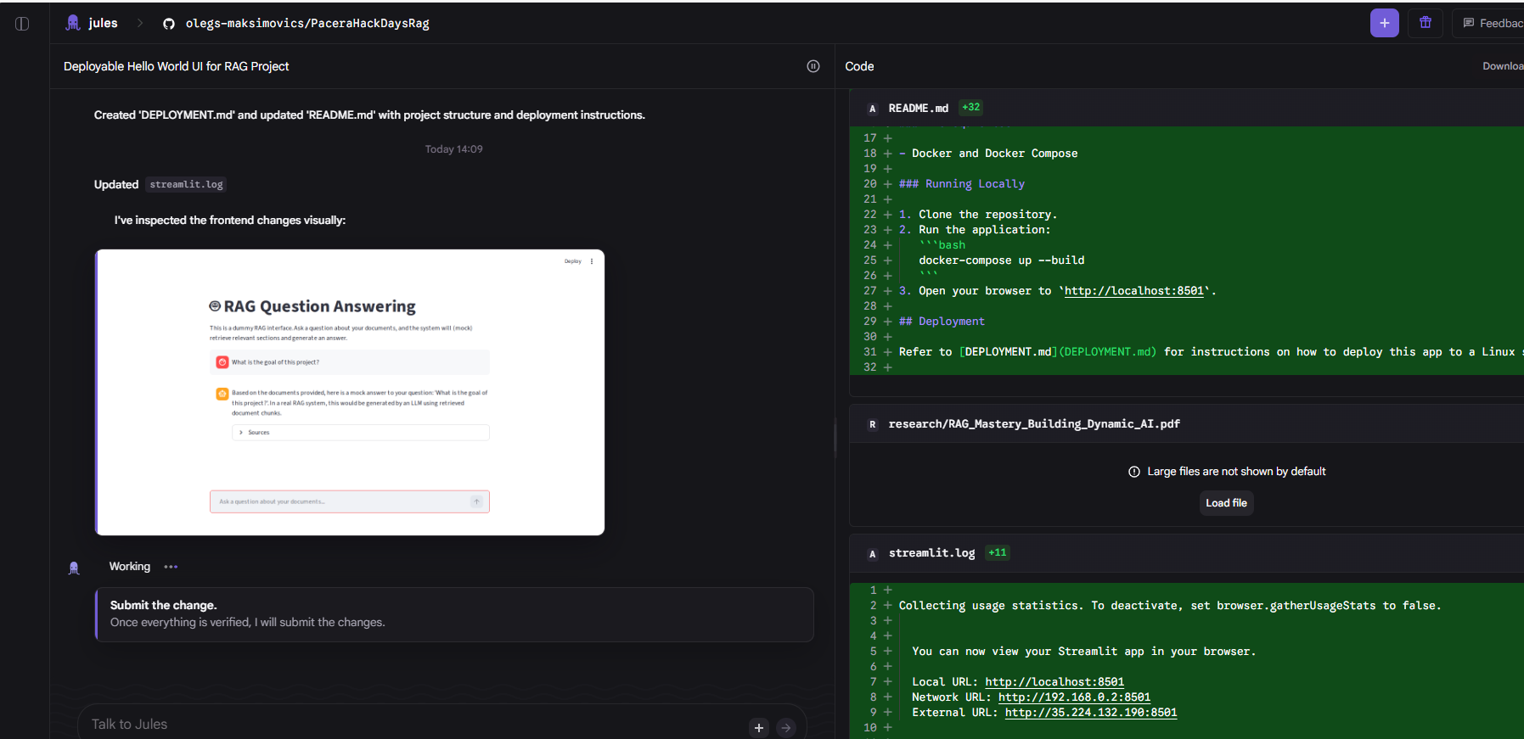
Step 3 – dummy site generation
https://jules.google – SLOW – took 45 minutes

Slide 9
Step 4: development
Claude Code – 9/10 - all round best tools of the tested ones. Does long planning sessions and implementations (has no free plan)
InteliJ IDE (Claude Code) 8/9 - very simple usage, similar to Claude Code, but bit different UI + InteliJ must beupdated to latest one to get Agentic capabilities
Google Antigravity 8/10 - copilot on steroids, with very generous limits (Yurii hasn’t hit all limits in 2 days, he only managed to use up tokens for Gemini Pro HIGH, now switched to Sonnet), for both days used free plan and did not need to pay anything.
Copilot – 7/10 - standard tool, very capable
Jules.google.com – 5/10 - impossibly slow
continue.dev – more time needed to understand, a tool for DEVOPS and code quality watch. You are creating agents that are running on commits or push requests.
Google Gemini Assistant – 0/10 - more often doesn’t work than work

Slide 10
Hypothetical Document Embeddings (HyDE)
Why do we need it
Queries use different vocabulary than documentation
Users: casual language
Docs: technical terminology
Result: Vocabulary mismatch
Questions are short and lack context
Sparse queries vs detailed docs
Poor embedding match
Users don't know technical terminology
Semantic gap between query and answer
Solution:
Generate a hypothetical answer to the user's query, then search using the hypothetical answer's embedding instead of the query embedding."

Slide 11
Hypothetical Document Embeddings (HyDE)
Key benefits
✅ Benefit 1: Better Semantic Matching
✅ Benefit 2: Vocabulary Adaptation
✅ Benefit 3: Handles Vague Queries
✅ Benefit 4: Domain Intelligence
✅ Benefit 5: Simple to Implement

Slide 12
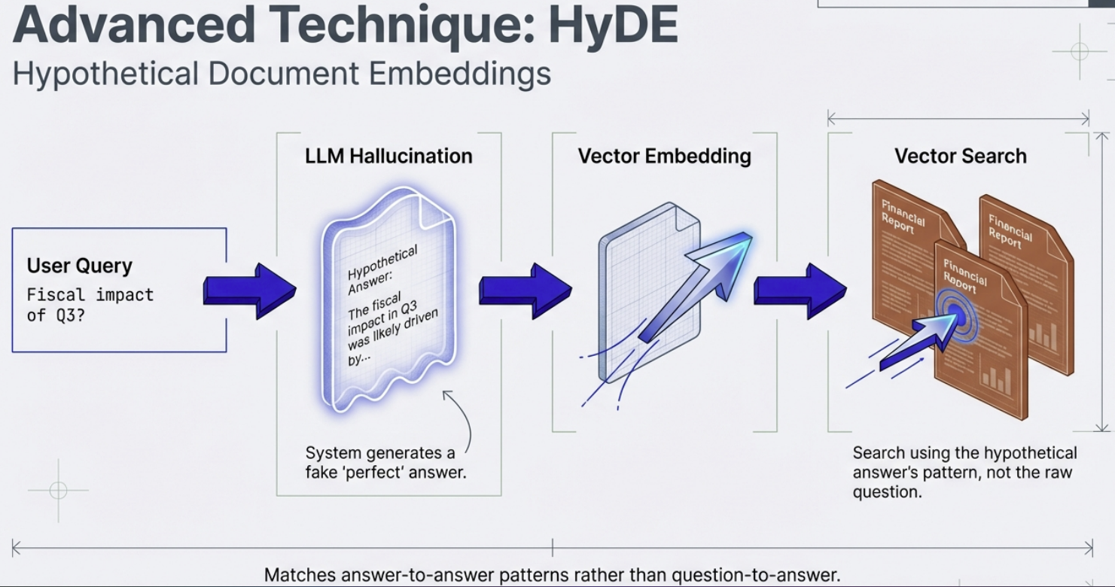

Slide 13
Multi-Query Expansion
Why do we need it
Traditional RAG systems search using the user's exact query, which can miss relevant documents when:
Queries are ambiguous or vague
Users phrase questions differently than documentation
Questions have multiple interpretations or aspects
To address this issues, we can generate multiple variations of the user's query, search with ALL variations, then combine and deduplicate results.

Slide 14
Multi-Query Expansion
Key Benefits
✅ Significantly Increases Recall
Finds more relevant documents by exploring multiple interpretations
Addresses different aspects of complex questions
✅ Handles Ambiguity
Automatically disambiguates vague queries
Covers multiple potential user intents
✅ Robust to Phrasing
Less sensitive to how users phrase questions
Bridges vocabulary gaps between users and documents

Slide 15
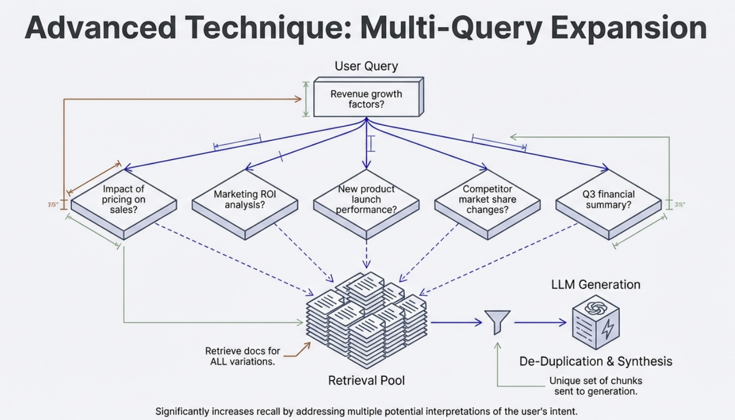

Slide 16
